Slide 3
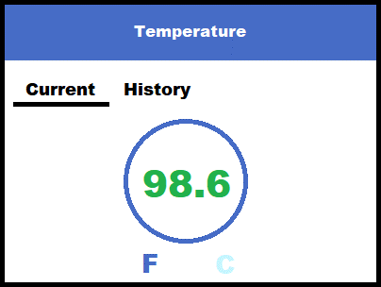
Maybe add a 3rd tab for “Settings?
Allow for customized green zone (safe)
Set upper and lower safe zones
Using that “custom range” numbers are green for inside range; red outside of range
Probably could blink number
Color challenged users cannot tell difference between red and green
Maybe add a Time/Date?
Would need time/date support
Calibration?

Slide 4
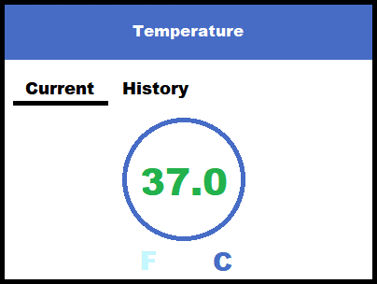
Touch area to toggle between the temperature scales of Fahrenheit and Celsius

Slide 5
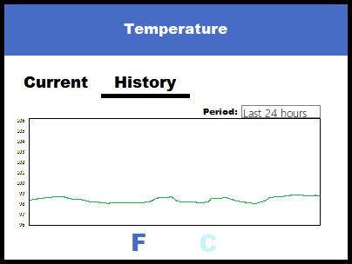
Store temperature data to Cloud?
By ID?
Privacy of data?
Period:
Last 24 hours
Last 7 days
Last 24 hours
Custom range

Slide 6
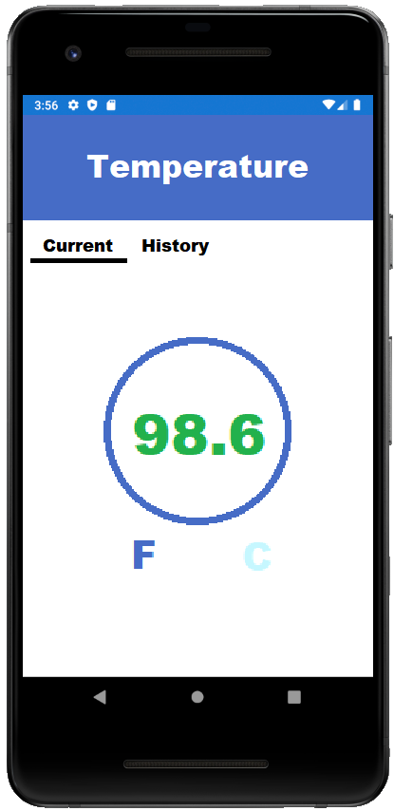

Slide 7
